Slide 1
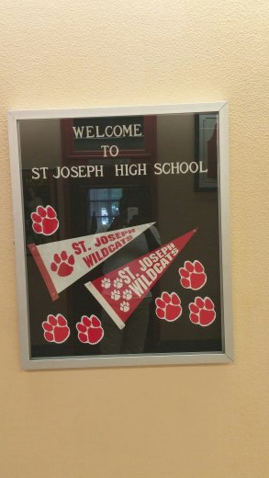
Story of St. Joe

Slide 2
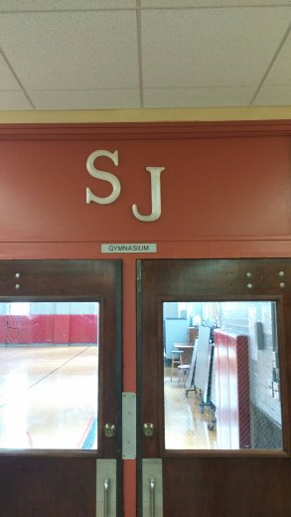
The symbol for St. Joe

Slide 3
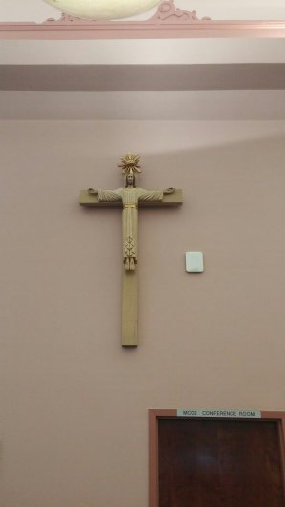
St. Joe high school represent christianty

Slide 4
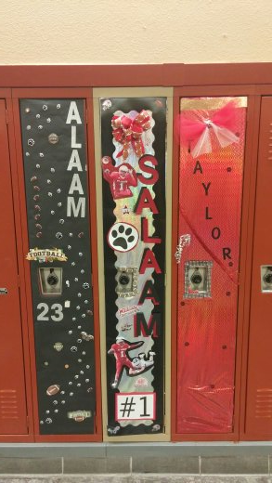
St. Joe senior locker decoration tradition

Slide 5
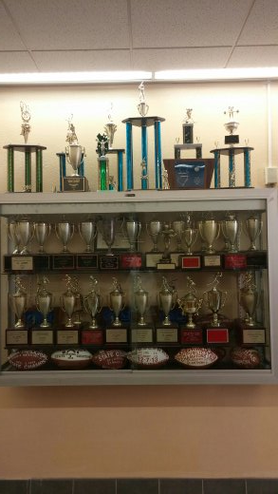
St. Joe has a winning tradition

Slide 6
Sign of faith

Slide 7
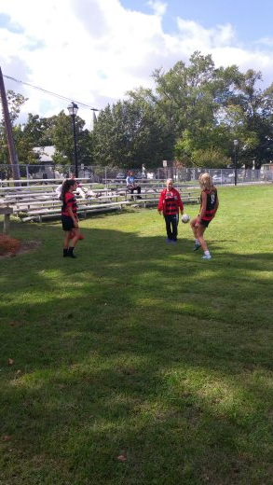
St. Joe friends having fun

Slide 8
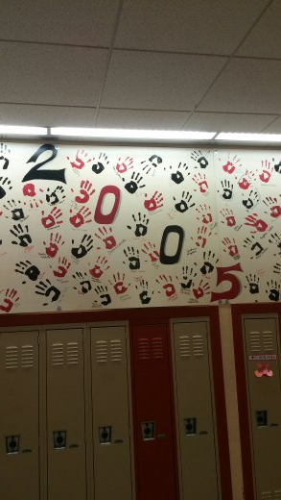
St. Joe hand prints once a wildcats always a wildcat

Slide 10
